Slide 1
Deploying Code with Kubernetes
February 22, 2020

Slide 2
OVERVIEW
Deployment Strategies:
Bare OS
VMs
Docker
Image & Container
Container Orchestration
Kubernetes Core Concepts
Pod
Manifest
Namespace
Deployment
Services
Ingress
Additional Concepts
2

Slide 3

DEPLOYING YOUR CODE
3

Slide 4
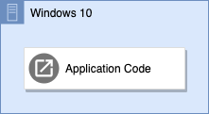
BARE OS – AS EASY AS IT GETS
HOW DOES IT WORK?
You do this every time that you compile and run your code locally
Application code is compiled into OS specific binaries (.exe’s for windows) and those binaries are placed on the target machine
Those binaries are executed, and the application runs directly on the host OS
PROS
Extremely simple and approachable
Good for IoT
Cons
Application is specific to host environment
Not scalable
Potentially unused resources
Expensive
4

Slide 5
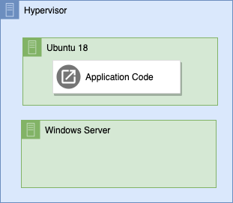
VMS – THE RIGHT DIRECTION
HOW DOES IT WORK?
Very common approach for both on premise and cloud environments
Application code is compiled into OS specific binaries (.exe’s for windows) and those binaries are placed on a Virtual Machine running on a hypervisor
Those binaries are executed, and the application runs on the guest operating system
PROS
Still very simple
Sharing space with other VMs
Cons
Application is specific to guest OS
Not scalable
Dependency management
5

Slide 6
DOCKER – IMAGE & CONTAINER
IMAGE
A Docker Image is an immutable definition to build a Docker Container
An image is assembled from multiple layers, starting with a root image, and then applying modifications to that image
As an example, the following Dockerfile describes how to build a container for a node web application
FROM node:10
# Create app directory
WORKDIR /usr/src/app
COPY package*.json ./
RUN npm install
# Bundle app source
COPY . .
EXPOSE 8081
CMD [ "npm", "start" ]
CONTAINER
A Docker Container is the instantiation (execution) of a Docker Image, resulting in a fully formed environment on which to run an application
6

Slide 7
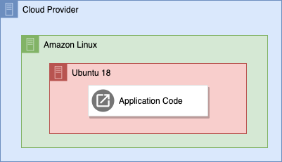
DOCKER – COOKING WITH GAS
HOW DOES IT WORK?
Application code is bundled along with supporting OS features into an Image, which is portable across anything that can run docker
Image is run as a Container, executing application code independently of the host OS
PROS
Extremely portable
Space efficient
Scalable
Cons
No coordination
Requires access to individual VM to deploy
7

Slide 8
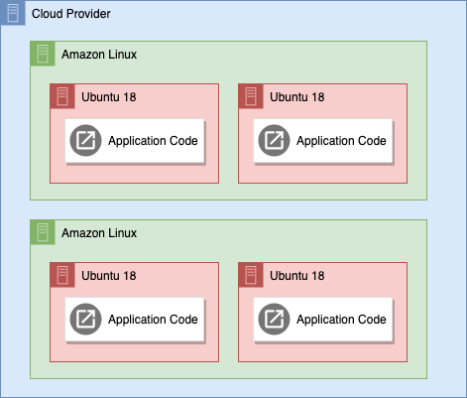
CONTAINER ORCHESTRATION
HOW DOES IT WORK?
Application code is bundled along with all supporting OS features into an Image, which is portable across anything with docker installed
Manifest file is created, outlining how the application should be run, how many applications should run, etc.
Manifest file is parsed, and Containers are run independently of host OS
PROS
Extremely portable
Space efficient
Auto Scalable
Hands off management
Declarative
Cons
Infrastructure overhead
8

Slide 9
KUBERNETES CORE CONCEPTS
9

Slide 10
KUBERNETES OVERVIEW
DESCRIPTION
“Containers are a good way to bundle and run your applications. In a production environment, you need to manage the containers that run the applications and ensure that there is no downtime. For example, if a container goes down, another container needs to start. Wouldn’t it be easier if this behavior was handled by a system?
That’s how Kubernetes comes to the rescue! Kubernetes provides you with a framework to run distributed systems resiliently. It takes care of scaling and failover for your application, provides deployment patterns, and more. For example, Kubernetes can easily manage a canary deployment for your system.”
10

Slide 11
MANIFEST
DESCRIPTION
The Kubernetes manifest is a fully formed definition of an application to be managed by Kubernetes
Manifests are defined in a single file in yaml format, named manifest.yml and are stored in source control. Manifest files may contain the following sections:
Namespace
Deployment
Service
Ingress
Service Monitor
Horizontal Pod Autoscaler
Volume Claims
Volume Definitions
Secrets
Config Maps
Each section of the manifest specifies its own version
11

Slide 12
NAMESPACE
DESCRIPTION
In Kubernetes, a Namespace is a logical grouping of applications forming a virtual cluster inside of a physical cluster
Namespaces can be used to break up the Kubernetes cluster by product, as seen in the diagram at right with each white box representing a different product’s namespace
The Kubernetes cluster also initially defines three namespaces:
default – default namespace
kube-system – Kubernetes system objects
kube-public – public readable namespace
Kubernetes Cluster Diagram
kind: Namespace
apiVersion: v1
metadata:
name: node-app
labels:
name: node-app
12

Slide 13
POD
DESCRIPTION
A pod is a logical combination of one or more containers, networking and storage designed to model a logical host, such as an entire VM that would previously run Windows, Tomcat and one or more web applications
Below is an example diagram of a Pod:
13

Slide 14
DEPLOYMENT
DESCRIPTION
A Kubernetes deployment defines the desired state of pods and replica sets (a set of identical pod)
Application teams will generally customize the following for their deployment:
Number of replicas
Container configuration
Resource requests and limits
Environment variables
Liveness and readiness probe definitions
Storage volume mount points and access tokens
REPLICAS
The deployment specification configures the initial number of replicas for a given application
The number of running instances can grow beyond the configured number by using manual scaling from the command line or by using a horizontal pod autoscaler
apiVersion: apps/v1
kind: Deployment
metadata:
name: node-app
spec:
replicas: 2
template:
metadata:
labels:
app: node-app
spec:
containers:
- name: node-app
image: node-app
ports:
- containerPort: 8081
14

Slide 15
SERVICE
DESCRIPTION
A service is a proxy that sits in front of one or more Pods, which have their own way of being accessed, providing a stable way from which to access the Pods being proxied; services register Pods by matching label selectors
Service definitions can also specify protocol (TCP, UDP, SCTP) and target port for the destination pod
For example, the following service definition, node-app-service, is looking for any pods with the label of node-app. Once it finds those pods it can load balance across them
apiVersion: v1
kind: Service
metadata:
name: node-app-service
labels:
run: node-app-service
spec:
ports:
- port: 8081
protocol: TCP
selector:
run: node-app
Pod
172.26.0 .12
Service
172.26.0.100
Pod
172.26.0.13
Pod
172.26.0.14
15

Slide 16
INGRESS
DESCRIPTION
A Kubernetes ingress defines a rule or set of rules by which an external application can access services in the cluster
In this example, we create the ingress node-app-ingress which exposes our node-app service to be accessed from outside of the cluster
Visit http://localhost to check it out.
apiVersion: networking.k8s.io/v1beta1
kind: Ingress
metadata:
name: node-app-ingress
spec:
backend:
serviceName: node-app
servicePort: 8081
16

Slide 17
Q&A
17

